Slide 1
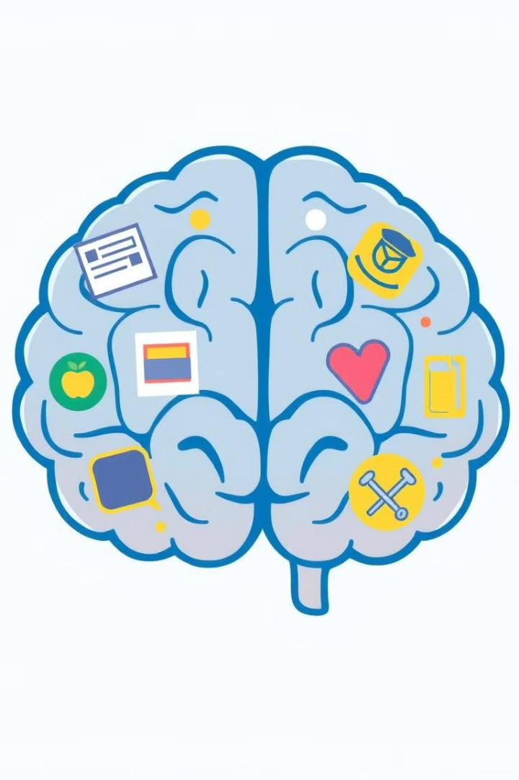
TEAM NO:014
MindTrack :AI Powered Mental Health and Daily Activity Correlation
This project explores the intricate relationship between daily activities and mental well-being. By analyzing data on technology usage, sleep patterns, and physical activity, we aim to uncover insights that can guide lifestyle choices for improved mental health outcomes.

Slide 2
Literature Review Summary
Reference | Dataset Used | EDA Steps Used | Features Extracted | ML Models | DL Models | Hyperparameters | Metrics | Advantages | Disadvantages
[1] | Mobile app user data | Normalization, balancing | App usage, frequency | SVM | None | Kernel type | F1-score, Recall | Accessible mental health support | Limited to self-reported data
[2] | NA | Data cleaning, text normalization | User interactions, mood scores | Decision Tree | RNN | Max depth, learning rate | Precision, Recall | Effective conversational support | Limited to predefined responses
[3] | WHO datasets | Standardization, imputation | Symptom severity, demographics | Logistic Regression | CNN | Penalty, epochs | Accuracy, Sensitivity | Broad global dataset | Limited real-time analysis
[4]. | Social media posts | Topic modeling, tokenization | Sentiment scores, key terms | SVM | BERT | Kernel, sequence length | F1-score, AUC | High accuracy in sentiment detection | Sensitive to data shifts
[5] | Survey data | Text cleaning, feature scaling | Anxiety levels, demographics | Gradient Boosting | None | Learning rate | RMSE | Real-time pandemic impact analysis | Limited to self-reported data
[6] | Behavioral health records | Normalization, outlier detection | Age, health records, visit frequency | KNN | LSTM | K-neighbors, epochs | MSE, Recall | Personalized intervention potential | Privacy concerns
[7] | Health records | Feature selection, encoding | Diagnosis codes, visit frequency | Random Forest | CNN | Max depth, tree count | ROC-AUC, Precision | High diagnostic accuracy | Resource-intensive
[8] | Wearable data | Signal processing, data smoothing | Heart rate, activity levels | Linear Regression | CNN | Regularization | Accuracy | Real-time monitoring capability | Device dependency
[9] | Social media & survey data | Text preprocessing, scaling | Emotion scores, usage frequency | Naive Bayes | Bi-LSTM | Alpha, sequence length | F1-score | Effective in early detection | Limited to text-based emotions
[10] | Social media text data | Text cleaning, sentiment extraction | Sentiment polarity, topic keywords | Logistic Regression | Transformers | Learning rate, sequence length | Accuracy, Recall | High scalability | Privacy concerns

Slide 3
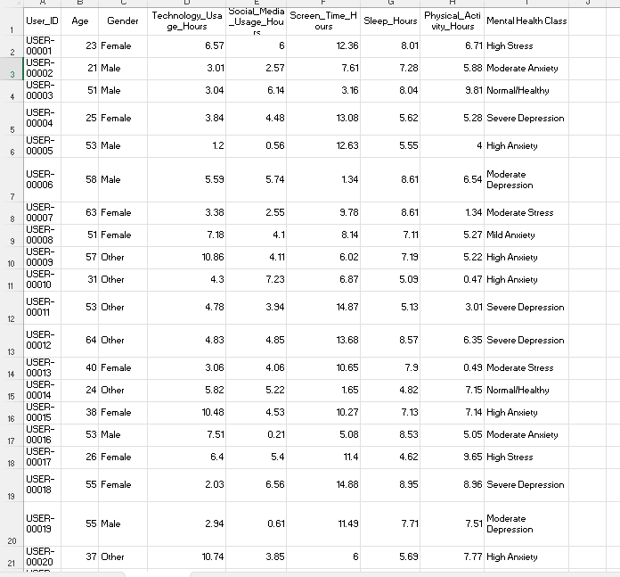
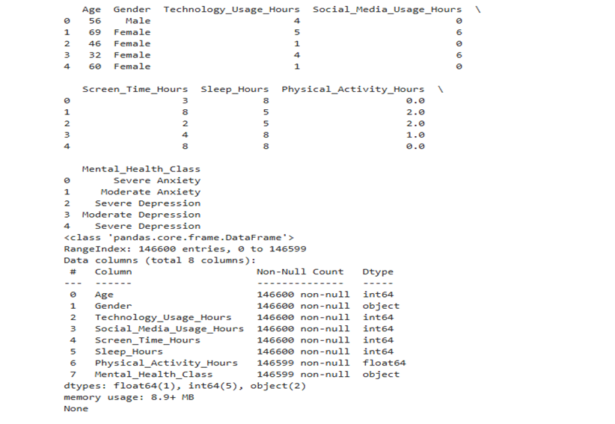
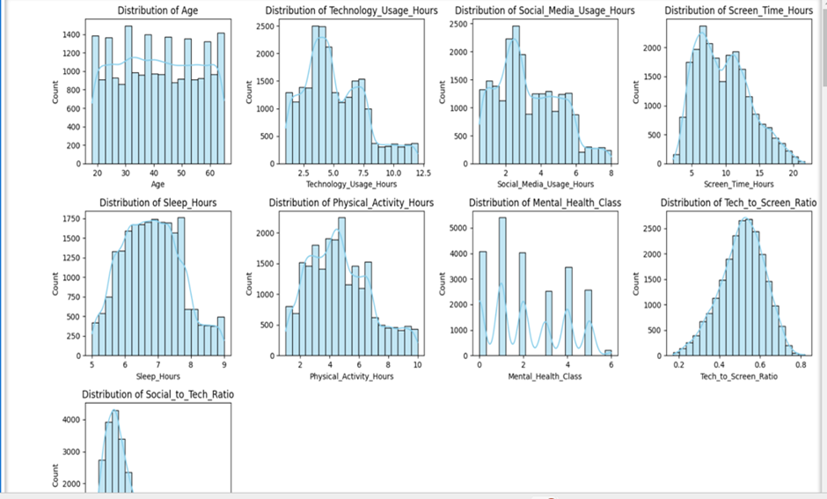
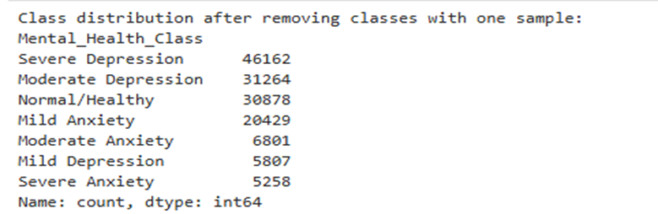

Dataset Description and EDA
Describe the dataset
Number of samples: Training (48,000), Testing (12,000).
Target: Mental Health Class (10 categories)
Activity Data
Demographics
Data Collection
User ID, age groups, and gender information to provide context for analysis.
Self-reported surveys, wearable devices, and mobile health apps for comprehensive data gathering.
And Kaggle
Technology usage, social media engagement, screen time, sleep duration, and physical activity hours.

Slide 4
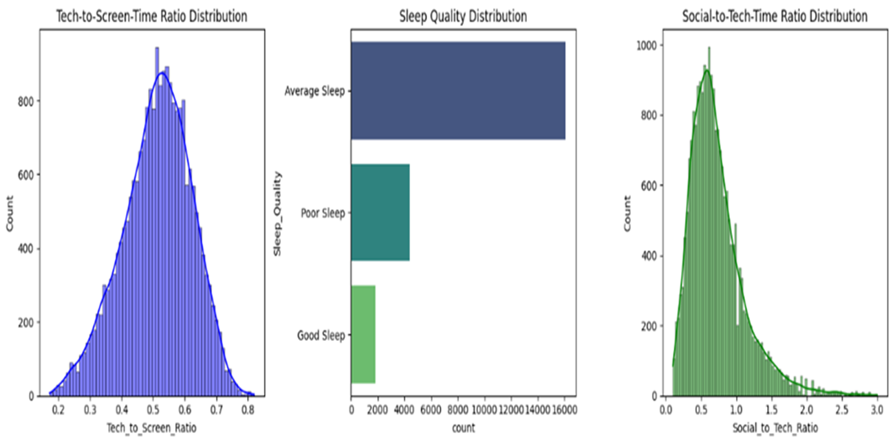
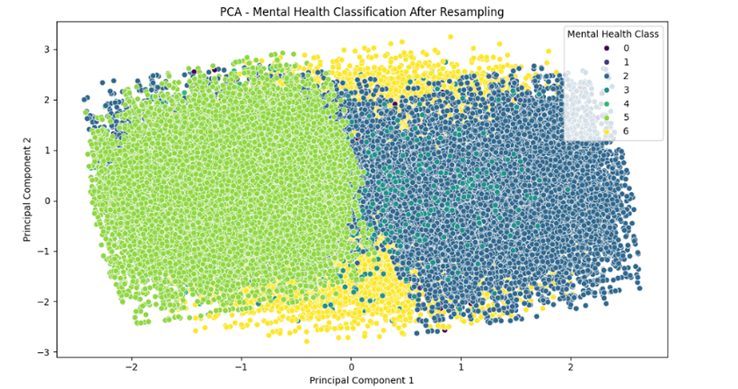
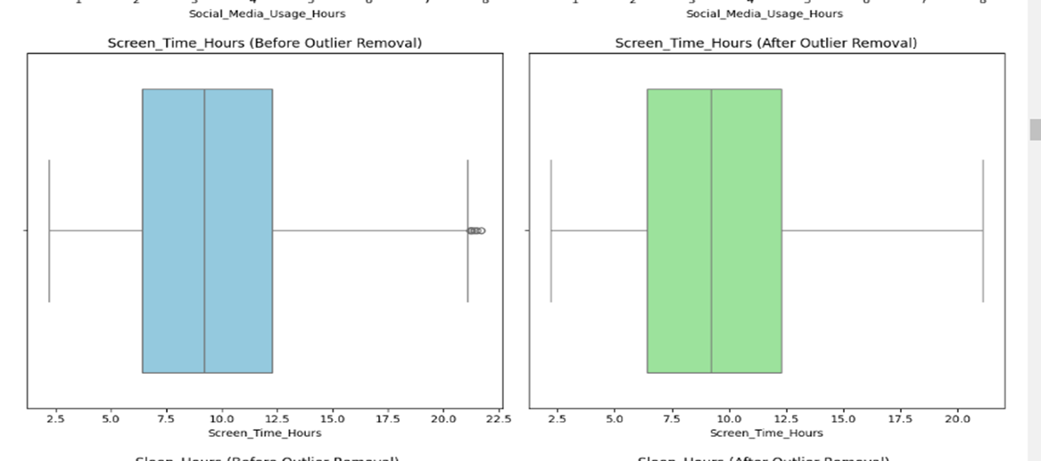
Data Engineering or Feature Extraction
Data Cleaning and Transformation Techniques Applied
Handling Missing Data: Missing values in key columns (e.g., Screen_Time_Hours, Social_Media_Usage_Hours, and Sleep_Hours) were filled using the median, as it is robust to outliers.
Feature Engineering: New features were derived, such as Tech_to_Screen_Ratio (ratio of technology usage to screen time), to explore correlations with mental health.
Normalization/Scaling: Features like Screen_Time_Hours were normalized using StandardScaler to bring all features onto a similar scale, enhancing model performance.
Current benchmark:

Slide 5
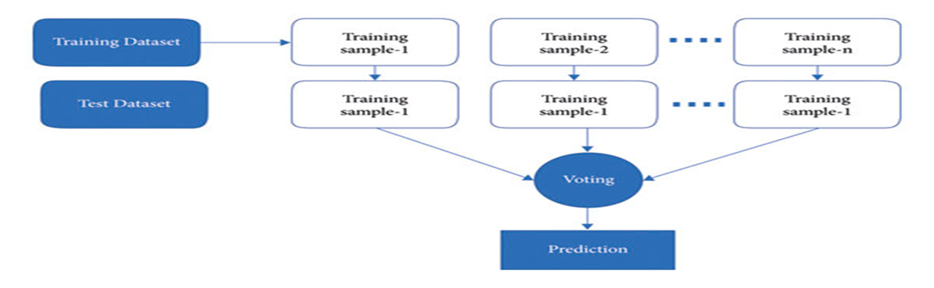
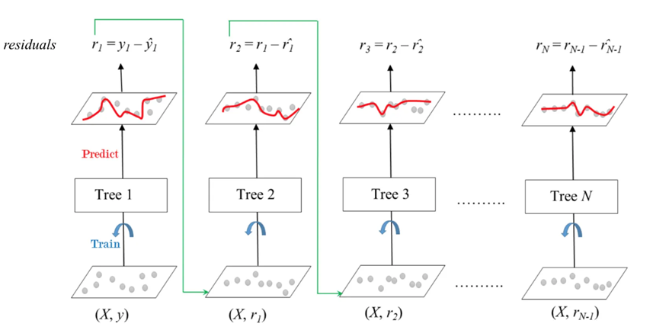
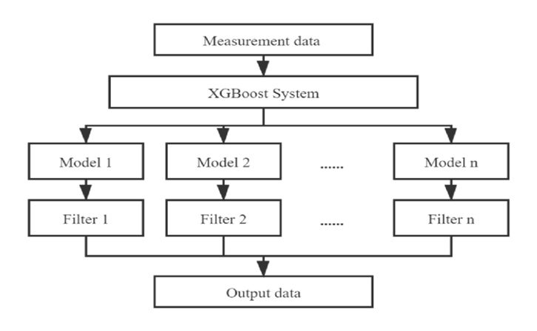
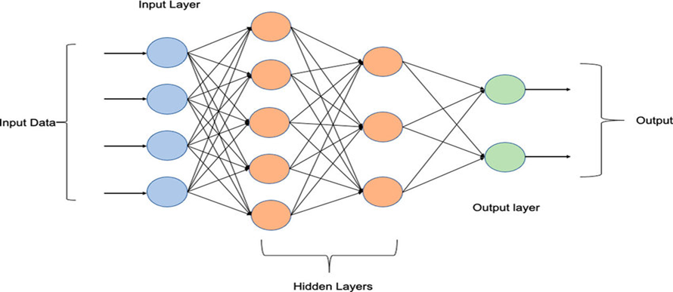

Model Architecture and Design (ML MODELS)
Random Forest:.
Gradient Boosting
XGBoost
MLP(1 hidden layer with 100 neurons.)

Slide 6
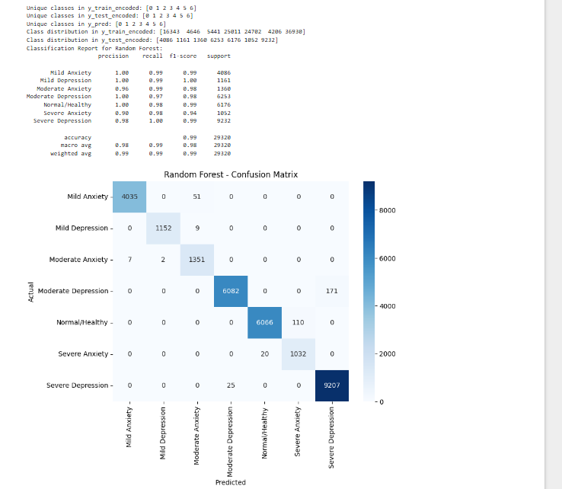
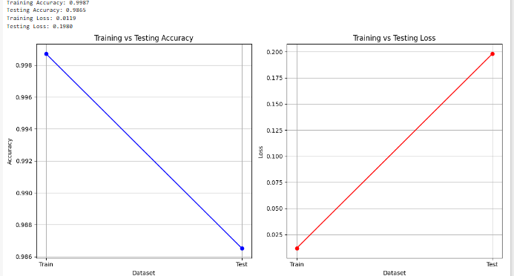
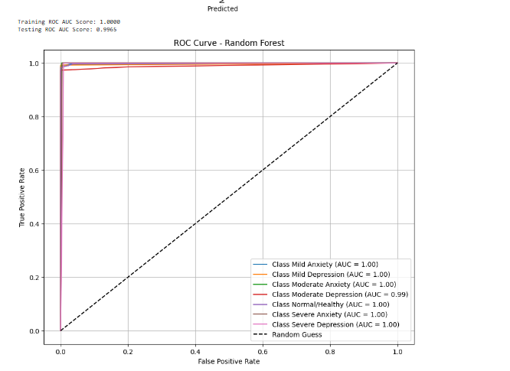
RANDOM FOREST

Slide 7
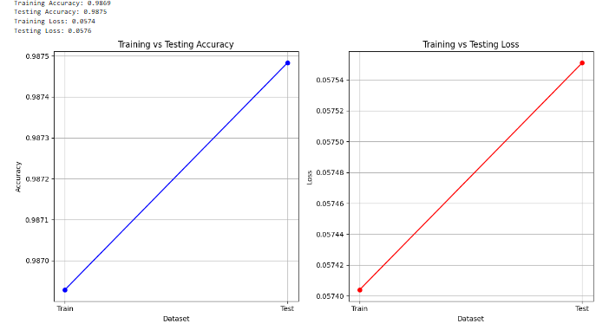
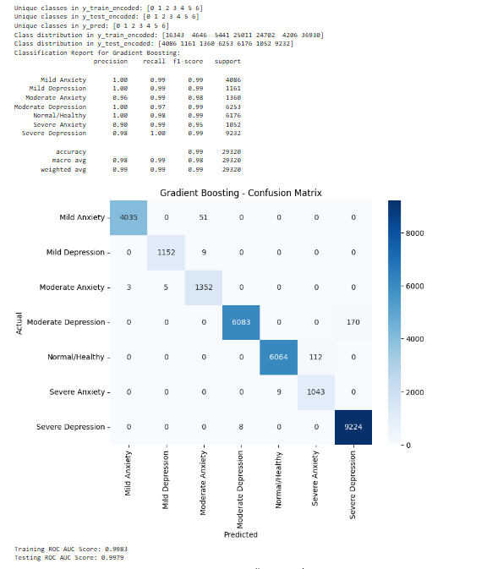
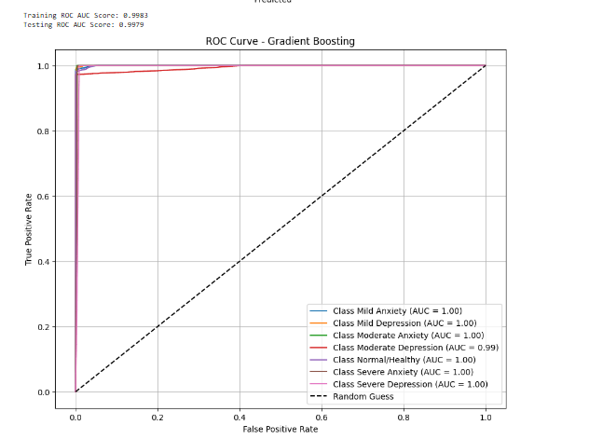
GRADIENT BOOSTING

Slide 8
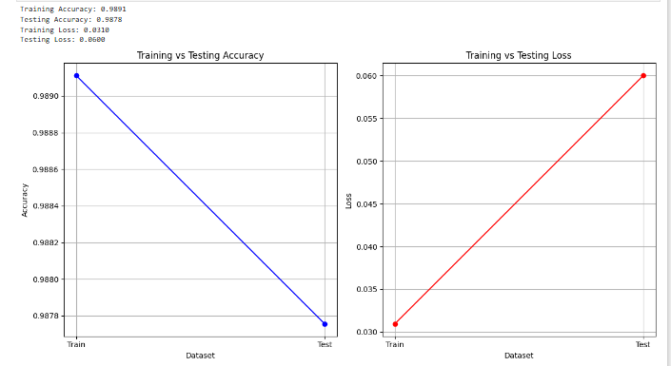
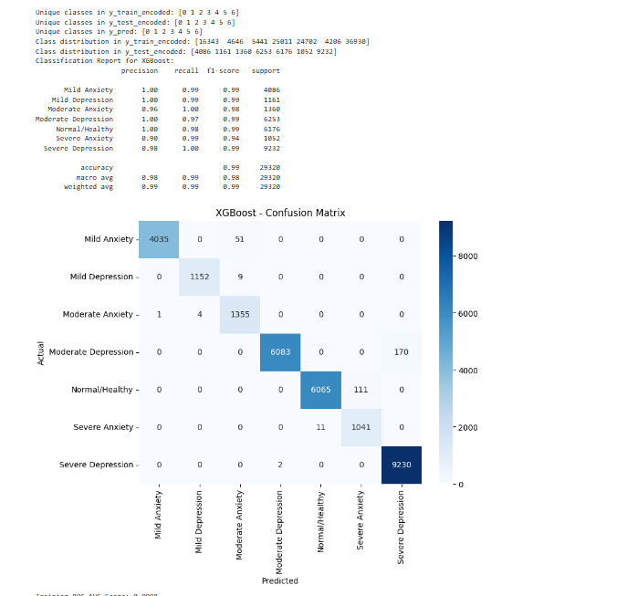
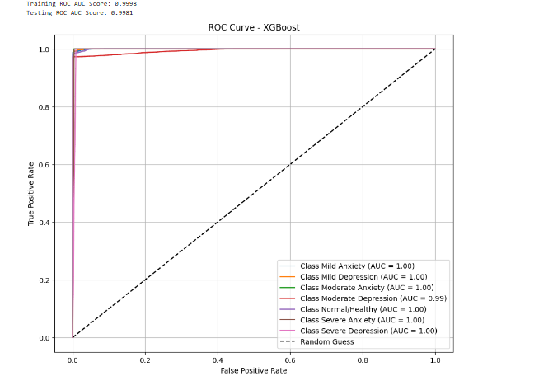
XGBoost

Slide 9
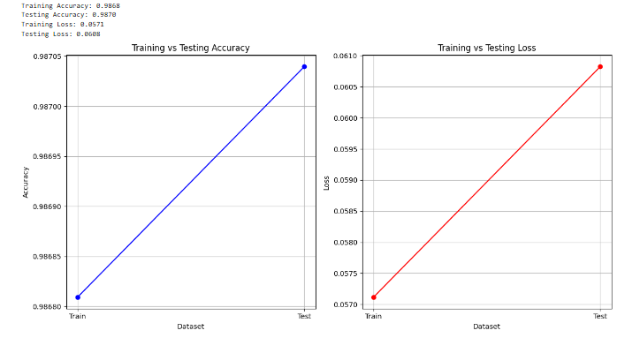
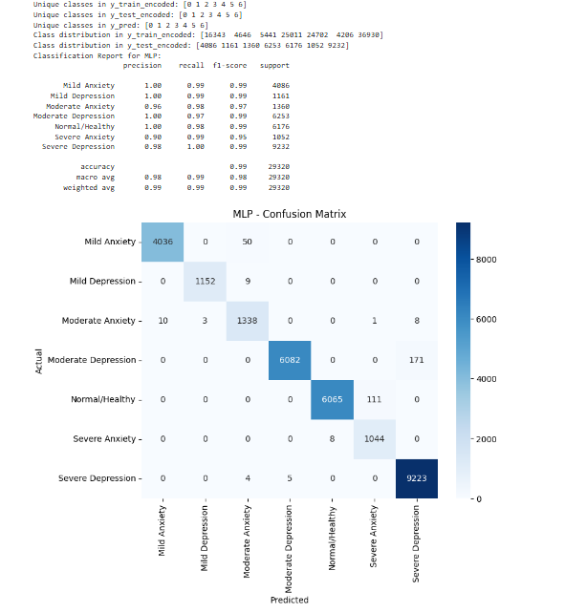
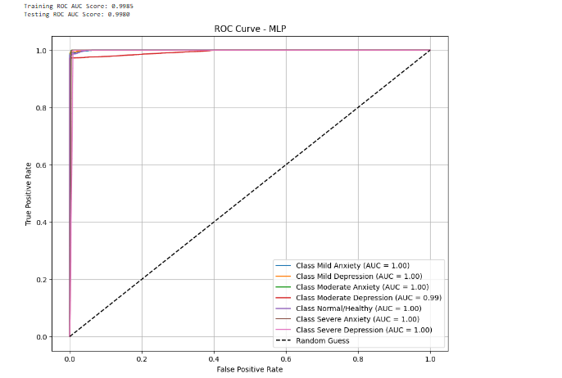
MLP (Multilayer Perceptron)

Slide 10
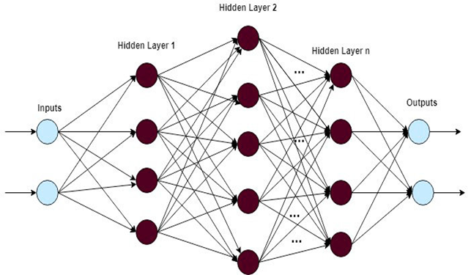
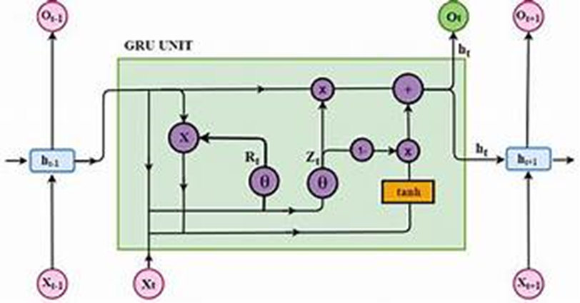
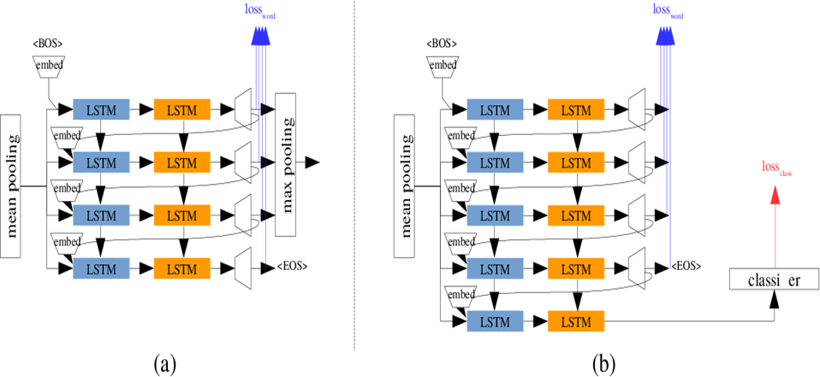
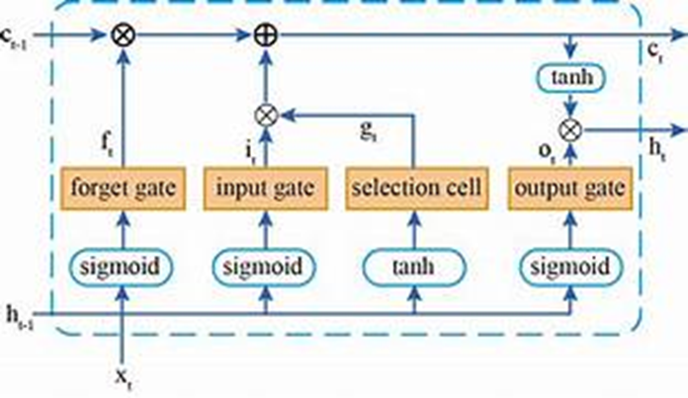
Model Architecture and Design (DL MODELS)
Deeper Neural Network(3)
GRU (Gated Recurrent Unit)(2)
LSTM (Long Short-Term Memory)(2)
LSTM with Batch Normalization(2)

Slide 11
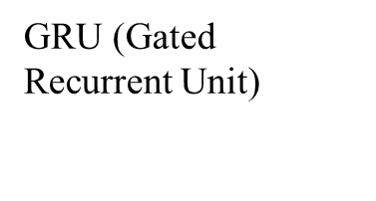

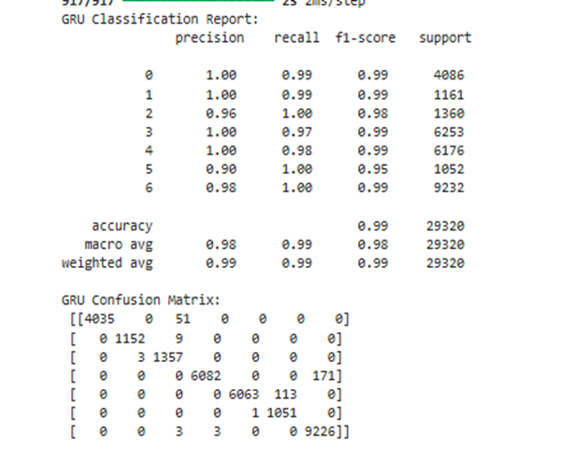
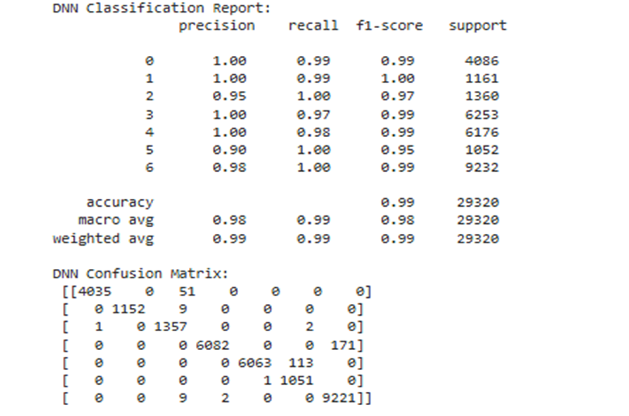
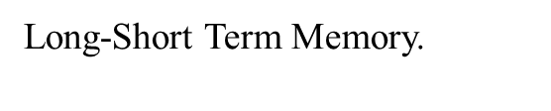
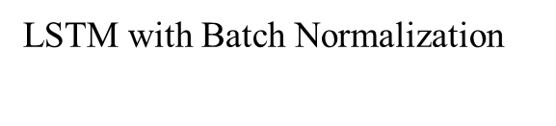
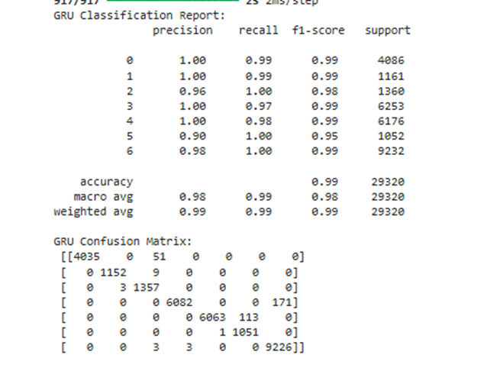
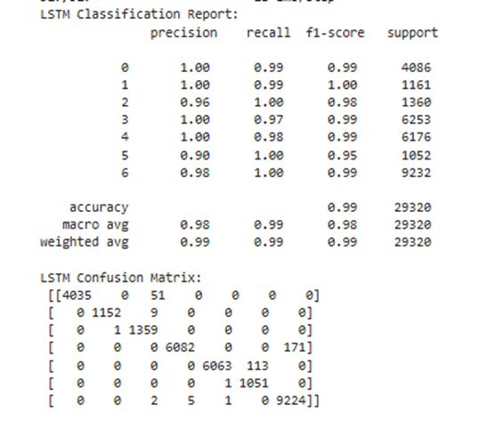
TOP ML MODEL

Slide 12
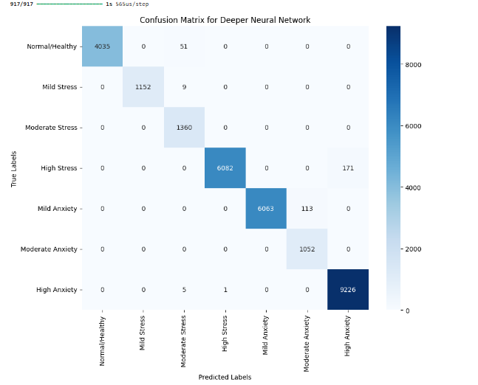
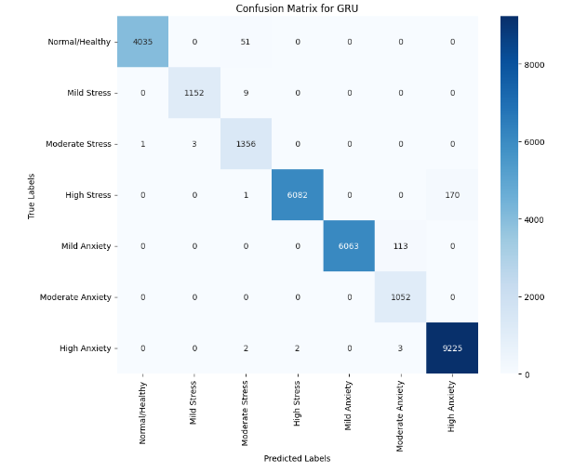
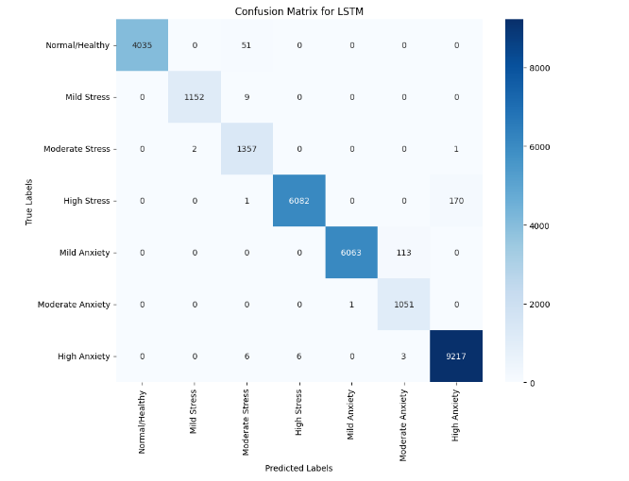
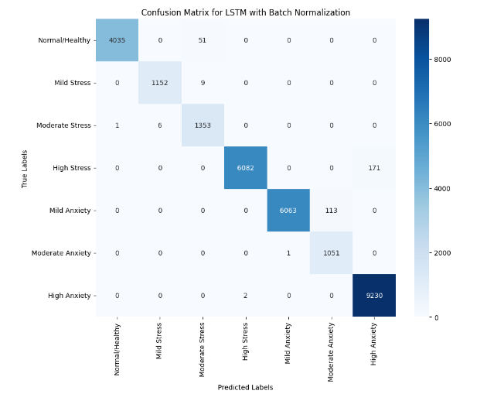
CONFUSION MATRIX

Slide 13
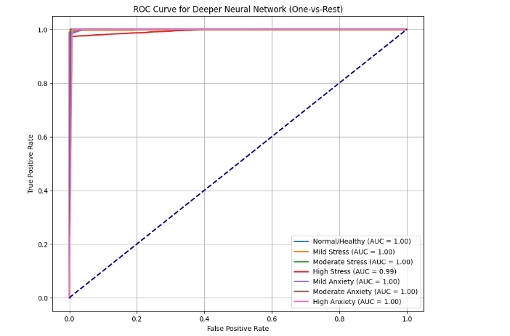
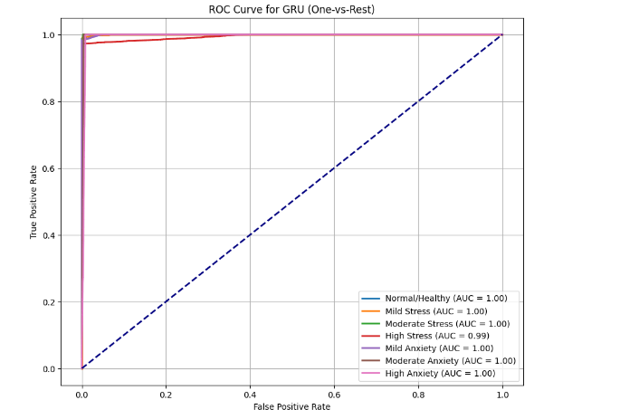
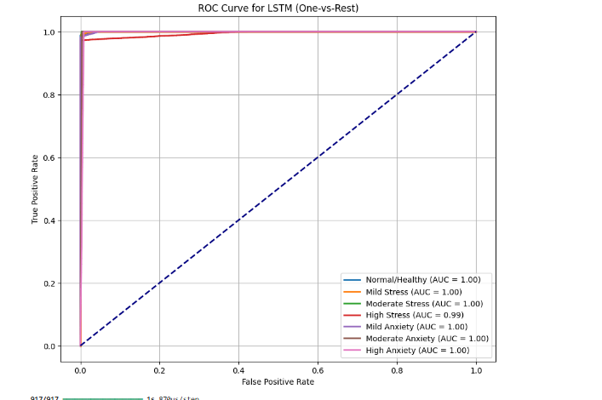
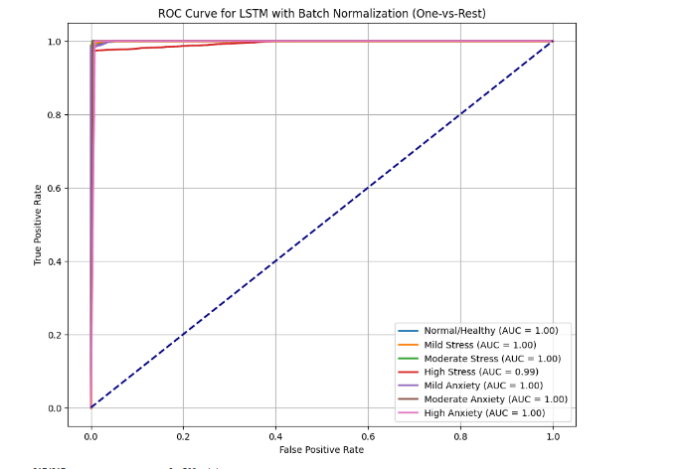

Slide 14
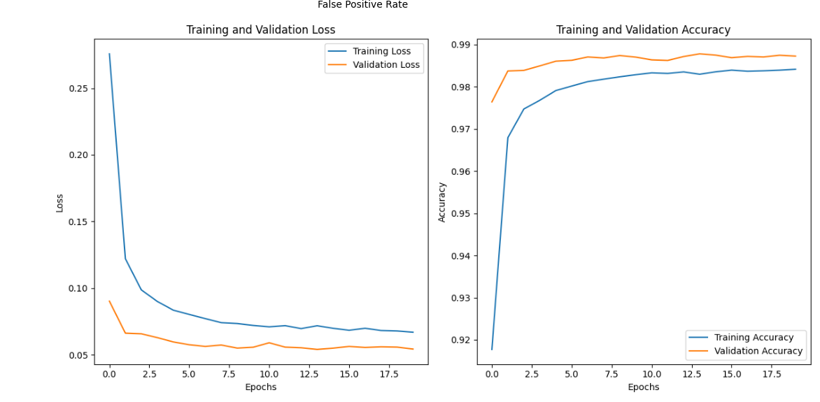
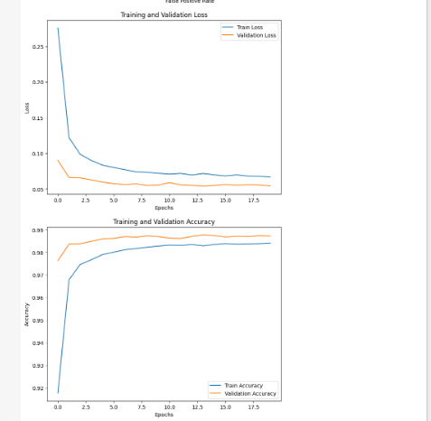
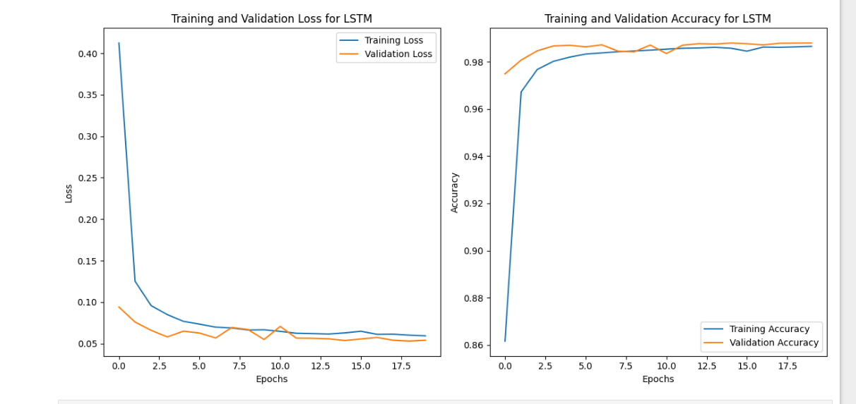
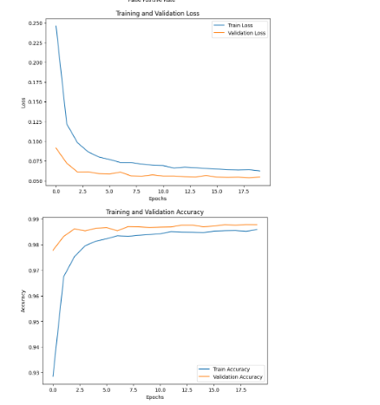

Slide 15

conclusion
Content:
Key Findings:
Best ML Model: XGBoost (Accuracy: 99%).
Best DL Model: Deeper Neural Network (Accuracy: 99%)
Impact:
"The project demonstrates the potential of AI in mental health classification and highlights the role of behavioral patterns in diagnosis."
Future Work:
Expanding dataset with real-time data.
Exploring ensemble methods for further accuracy improvements.

Slide 16
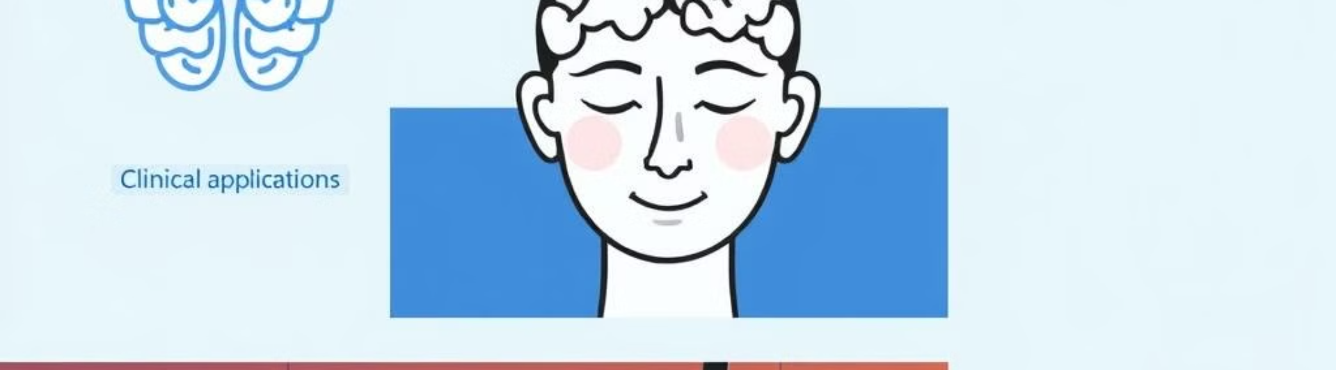
References
[1] F. Mustač et al., "How to maintain mental health in turbulent times: Can mobile applications be a part of the solution?," 2021 6th International Conference on Smart and Sustainable Technologies (SpliTech), Bol and Split, Croatia, 2021, pp. 1-5, doi: 10.23919/SpliTech52315.2021.9566350.
[2] C. Zhang et al., "AI Chatbots for Mental Health: A Scoping Review," Applied Sciences, vol. 14, no. 13, pp. 5889, 2022. doi: 10.3390/app14135889.
[3]World Health Organization, "Artificial intelligence in mental health research: New WHO study on applications and challenges," WHO, Mar. 2021. [Online]. Available: https://www.who.int/news/item/10-03-2021-artificial-intelligence-in-mental-health-research
[4] S. Banerjee et al., "Mental Health Applications of Generative AI and Large Language Modeling in the United States," Int. J. Environ. Res. Public Health, vol. 21, no. 7, pp. 910, 2024. doi: 10.3390/ijerph21070910.
[5] M. Huang and Y. Lin, "Exploring the Role of AI in Mental Health Support During COVID-19: A Review," J. Affect. Disord., vol. 317, pp. 109-118, 2022. doi: 10.1016/j.jad.2022.02.016.
[6] T. Smith et al., "Machine Learning Approaches to Predict and Prevent Mental Health Disorders," Psychiatry Research, vol. 327, pp. 115488, 2023. doi: 10.1016/j.psychres.2023.115488.
[7] A. Davis and J. Roy, "AI-Based Assessment of Mental Health: Advances, Opportunities, and Ethical Challenges," Front. Psychiatry, vol. 12, pp. 786259, 2021. doi: 10.3389/fpsyt.2021.786259.
[8] L. Patel et al., "Personalized Mental Health Interventions with Machine Learning and Wearables," Computers in Biology and Medicine, vol. 150, pp. 103762, 2022. doi: 10.1016/j.compbiomed.2022.103762.
[9] R. Gupta and S. Patel, "The Use of AI for Mental Health Monitoring in Adolescents," Healthcare, vol. 10, no. 4, pp. 601, 2022. doi: 10.3390/healthcare10040601.
[10] Y. Zhao et al., "Natural Language Processing in Mental Health: Applications and Emerging Trends," PLoS ONE, vol. 17, no. 5, e0269257, 2022. doi: 10.1371/journal.pone.0269257.

